Slide 1


Self-Admitted Technical Debt: Recent Results and Future Challenges
Emad Shihab
Assistant Professor
Dept. of Computer Science & Software Engineering

Slide 2
What is Technical Debt?
“Shipping first-time code is like going into debt. A little debt speeds development so long as it is paid back promptly…”
-Cunningham
Notes:
Identification of SATD patterns was performed manually and is prone to human error and/or subjectivity
Our study only focuses on SATD and not all forms of technical debt.

Slide 3

What is Technical Debt?
Something that is beneficial in the short term but will incur a cost later on
Examples of technical debt
Workarounds
Temporary fixes
Notes:
- A definition coined by Ward Cunningham in 1992 which can be called a consequence of poor design, implementation choices
- Developers commit workarounds or temporary fixes to achieve deadlines, satisfy customers, or reduce hours spent on it

Slide 4

Types Technical Debt?
There are many types of technical debt:
Design debt
Testing debt
Defect debt
Documentation debt
…
Notes:
- A definition coined by Ward Cunningham in 1992 which can be called a consequence of poor design, implementation choices
- Developers commit workarounds or temporary fixes to achieve deadlines, satisfy customers, or reduce hours spent on it

Slide 5
Effects of Technical Debt
Prior work showed that technical debt negatively impacts quality
Most work used existing tools capable of only
identifying (a specific type of) design debt
What about other types of
technical debt?
Notes:
-
* This is where our study comes in

Slide 6
How Can We Identify “other” Types of Technical Debt?
We use source-code comments to identify technical debt
^
self admitted

Slide 7
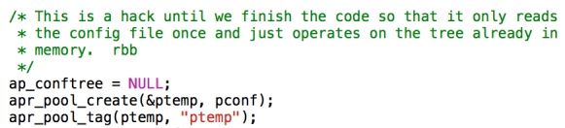
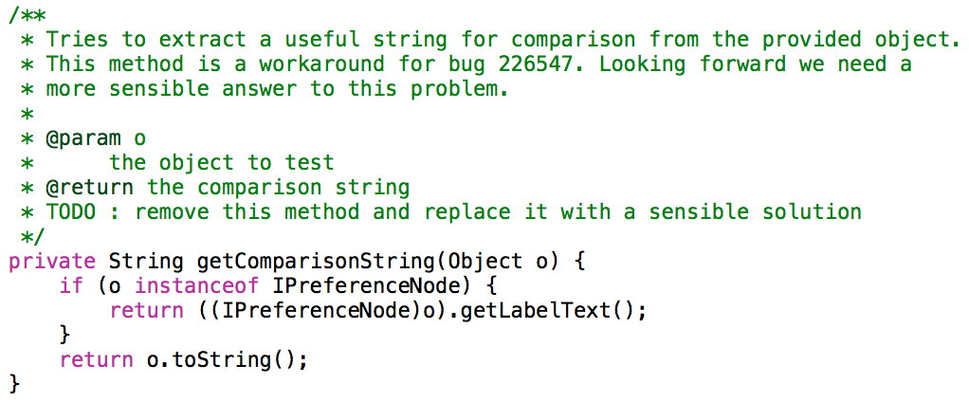
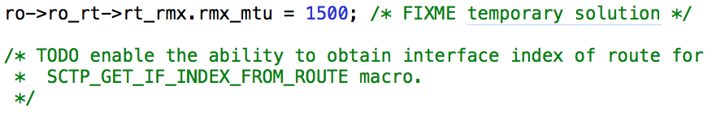
Examples of Self-admitted Technical Debt
Notes:
main.c – Apache HTTP Server
ContributionComparator.java – Eclipse
sctp_os_userspace.h – Chromium OS

Slide 8
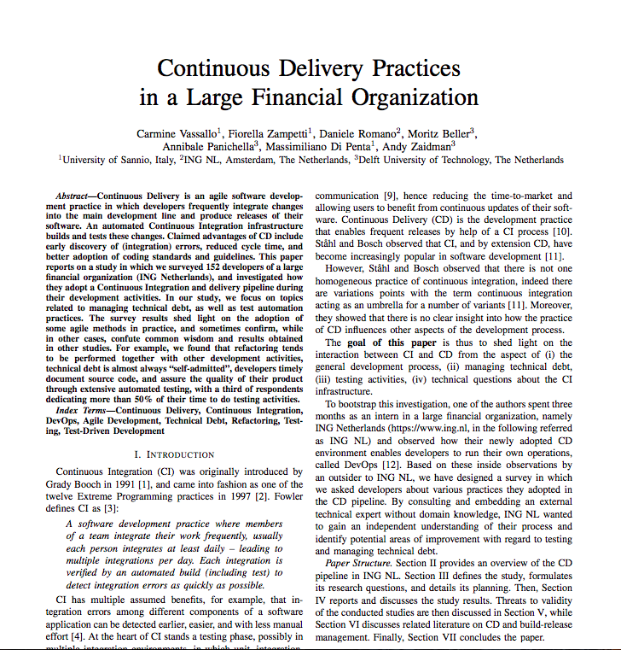

Developers Mention Technical Debt In Code Comments
“88% of poor implementation choices are annotated through code comments, i.e. SATD”

Slide 9
Exploratory Study on SATD
How much self-admitted technical debt exists in the studied software projects?
Why is self-admitted technical debt introduced into the software project?
How much self-admitted technical debt is removed after its introduction?
Notes:
- To understand self-admitted technical debt, we study the following research questions.
3. When self-admitted technical debt is introduced, it is meant to be removed or addressed later on, we want to empirically quantify how much of this technical debt is actually removed

Slide 10






Approach Overview
srcML
Mine Source Code
Parse code using srcML
Read comments to identify patterns
~ 22,818 files
~ 101,762 comments
62 recurring patterns
Analyze projects and answer Qs
Search patterns across projects
4 projects
Notes:
- srcML – A command-line tool that converts source code into XML files
- srcML makes it easier to identify only comment lines and find the parent they are nested in
* We make the list of patterns and rest of the dataset publicly available and the link is available in the paper

Slide 11

Sample Patterns
hack
ugly
remove this
nuke
workaround for bug
fix this crap temporary crutch probably a bug
abandon all hope
remove me before production

Slide 12
Research questions
How much self-admitted technical debt exists in the studied software projects?
Why is self-admitted technical debt introduced into the software project?
How much self-admitted technical debt is removed after its introduction?

Slide 13




Case Study Projects
ArgoUML
Projects | Release | Release Date | Lines of Code | Comment Lines | Committers
Eclipse | 4.3 | 06/2013 | 659,231 | 437,640 | 221
Chromium OS | 30 | 09/2009 | 107,706 | 37,889 | 1,784
ArgoUML | 0.34 | 12/2011 | 122,575 | 115,713 | 53
Apache httpd | 2.4.6 | 07/2013 | 192,333 | 54,295 | 145
Notes:
- All projects have a lenghty development history and have well-commented source code
- Latest available releases of software projects

Slide 14


RQ1: How much self-admitted technical debt exists?
srcML
Mine Source Code
Parse code using srcML
Search patterns across projects
Quantify technical debt pattern

Slide 15
RQ1: Results
How much self-admitted technical debt exists in the studied software projects?
 | Project | Total | % files with technical debt
File | Eclipse | 6,389 | 2.4
 | Chromium OS | 14,328 | 4.0
 | ArgoUML | 1,846 | 4.2
 | Apache httpd | 255 | 31.0
Class | Eclipse | 11,993 | 1.3
 | Chromium OS | 18,249 | 0.4
 | ArgoUML | 2,304 | 3.3
 | Apache httpd | - | -
Notes:
- We find that SATD heavily depends from project to project. In some projects, we encounter as little as 2.4% of files containing SATD, and some projects containing SATD as high as 31%

Slide 16


RQ2: Why is Self-Admitted Technical Debt Introduced?
Developer Experience – do less experienced developers introduce more technical debt?
Time to release – do tight release deadlines lead to more technical debt?
Notes:
- Investigate three factors that might be leading to introduction of SATD

Slide 17



RQ2 – Developer Experience
Experience measured using number of prior commits
git/svn blame
Identify
technical debt
Identify
developer
Count number of
prior commits
Rank developers in order of experience for comparison
Notes:
- We identified when in a developers history he made that commit
- We also rank the developers in order of experience i.e. total commits

Slide 18
RQ2 – Developer Experience Results
Project | Dev | Technical Debt | Total Commits | Experience Rank | Total Committers
Eclipse | E1 | 21 | 1,231 | 8 | 221
 | E2 | 20 | 2,513 | 2
Chromium OS | C1 | 28 | 4,853 | 1 | 1,784
 | C2 | 24 | 410 | 219
ArgoUML | AU1 | 17 | 2,544 | 4 | 53
 | AU2 | 7 | 4,879 | 1
Apache httpd | AH1 | 14 | 4,908 | 1 | 145
 | AH2 | 13 | 3,214 | 3
Developers with higher experience introduce more self-admitted technical debt
Notes:
- Table sorted based on SATD

Slide 19
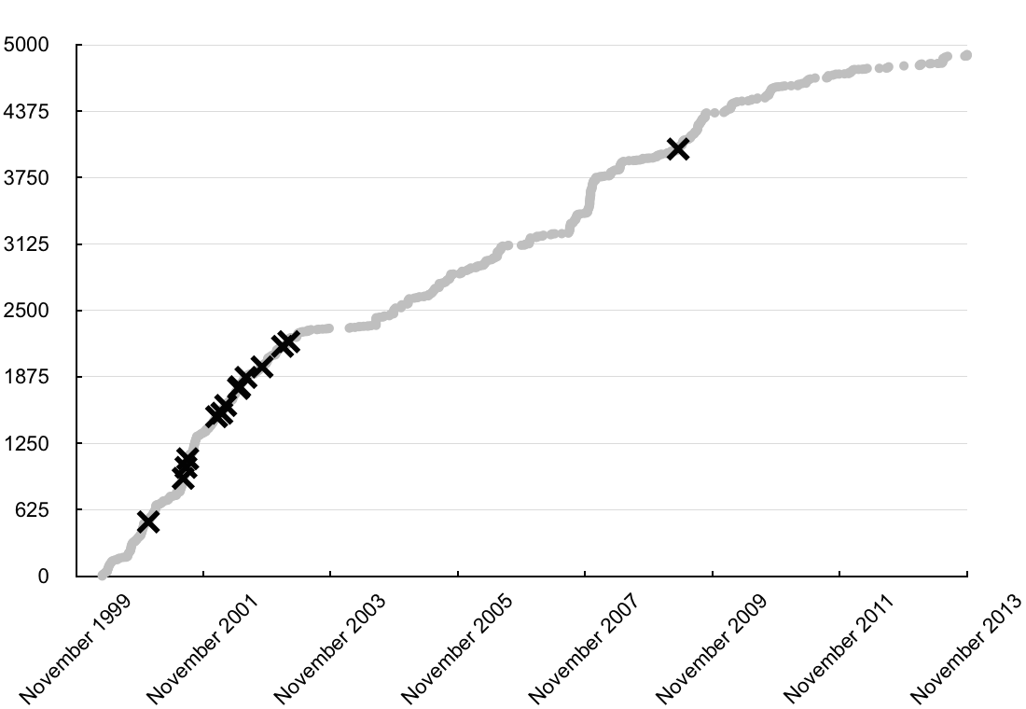
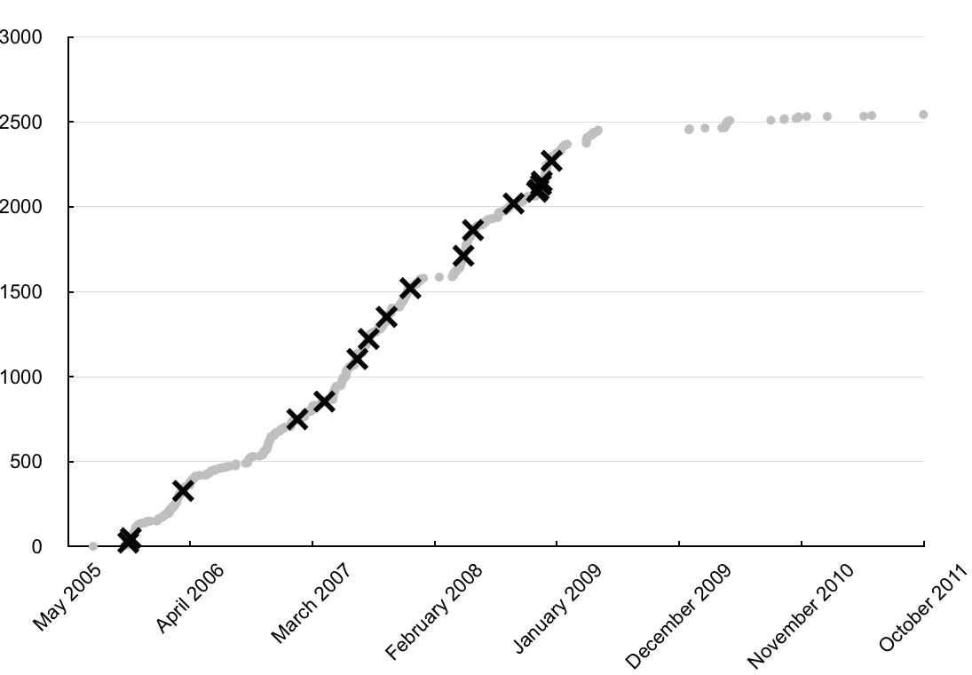
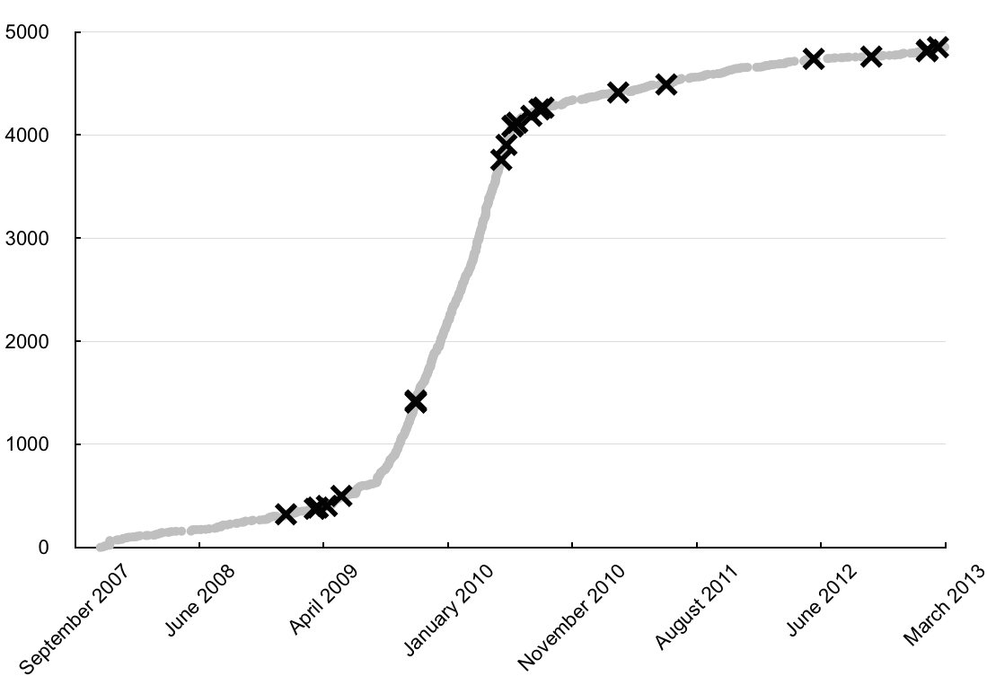
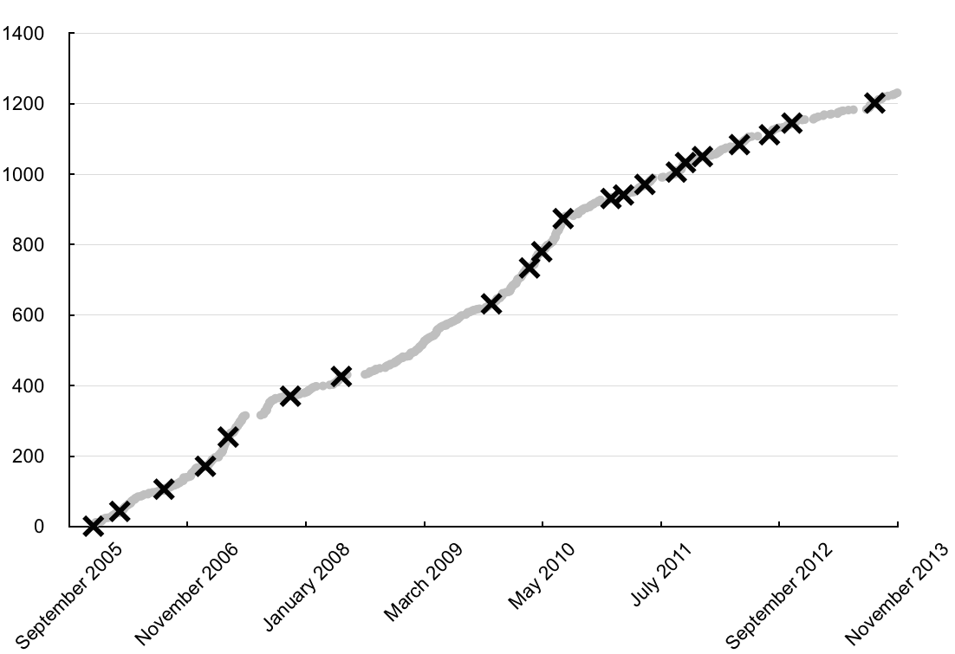
RQ2 – Developer Experience Results
Apache
ArgoUML
Chrome
Eclipse
Notes:
- Table sorted based on SATD

Slide 20
RQ2: Why is Self-Admitted Technical Debt Introduced?
Developer Experience – do less experienced developers introduce more technical debt?
Time to release – do tight release deadlines lead to more technical debt?
Notes:
- Investigate three factors that might be leading to introduction of SATD

Slide 21
Release Pressure
Measure how close to a release the self-admitted technical debt is introduced
>6 months
>1 month & <= 3 months
>3 months & <= 6 months
<= 1 month

Slide 22
RQ2 – Release Pressure Results
Project | Time to Release | % Technical debt | % over all changes
Eclipse | >= 6m | 41.7% | 0.33%
 | >= 3m & <= 6m | 36.4% | 0.64%
 | >= 1m & <= 3m | 16.7% | 0.39%
 | <= 1m | 5.3% | 0.39%
ArgoUML | >= 6m | 33.3% | 0.20%
 | >= 3m & <= 6m | 41.7% | 0.34%
 | >= 1m & <= 3m | 16.7% | 0.19%
 | <= 1m | 8.3% | 0.23%
Apache httpd | >= 6m | 37.5% | 0.22%
 | >= 3m & <= 6m | 31.6% | 0.31%
 | >= 1m & <= 3m | 20.6% | 0.24%
 | <= 1m | 10.3% | 0.21%
Notes:
- The % technical debt instances is the percentage of technical debt instances over all the time frames

Slide 23
Research questions
How much self-admitted technical debt exists in the studied software projects?
Why is self-admitted technical debt introduced into the software project?
How much self-admitted technical debt is removed after its introduction?

Slide 24
Technical Debt Removal
“…a little debt speeds development so long as it is paid back promptly…the danger occurs when the debt is not repaid…”
-Cunningham
Notes:
Identification of SATD patterns was performed manually and is prone to human error and/or subjectivity
Our study only focuses on SATD and not all forms of technical debt.

Slide 25




RQ3: How much self-admitted technical debt is removed?
Identify self-admitted technical debt in a base version
Compare and identify self-admitted technical debt in future releases
Notes:
- To determine how much self-admitted technical debt is removed, we compute how much of the self-admitted technical debt that was introduced remains in future releases
- Once we identify a pattern in the base release, we attempt to identify the whole comment line in the following release since lines may get moved around

Slide 26
RQ3: Results - Eclipse
Eclipse Versions | Release Date | Removed self-admitted technical debt | Change
3.0 - > 3.0 | June 2004 | - | -
3.0 - > 3.1 | June 2005 | 26.3% | 26.3%
3.0 - > 3.2 | June 2006 | 27.9% | 1.6%
3.0 - > 3.3 | June 2007 | 29.9% | 2%
3.0 - > 3.4 | June 2008 | 35.6% | 5.7%
3.0 - > 3.5 | June 2009 | 35.6% | 0%
3.0 - > 3.6 | June 2010 | 36.9% | 1.3%
3.0 - > 3.7 | June 2011 | 36.9% | 0%

Slide 27
RQ3: Results - ArgoUML
ArgoUML Versions | Release Date | Removed self-admitted technical debt | Change
0.20 - > 0.20 | February 2006 | - | -
0.20 - > 0.22 | August 2006 | 37.3% | 37.3%
0.20 - > 0.24 | February 2007 | 41.3% | 4.0%
0.20 - > 0.26 | September 2008 | 58.7% | 17.4%
0.20 - > 0.28 | March 2009 | 62.7% | 4.0%
0.20 - > 0.30 | March 2010 | 65.3% | 2.6%
0.20 - > 0.32 | January 2011 | 65.3% | 0%
0.20 - > 0.34 | December 2011 | 65.3% | 0%

Slide 28
Follow-on work
Notes:
Identification of SATD patterns was performed manually and is prone to human error and/or subjectivity
Our study only focuses on SATD and not all forms of technical debt.

Slide 29
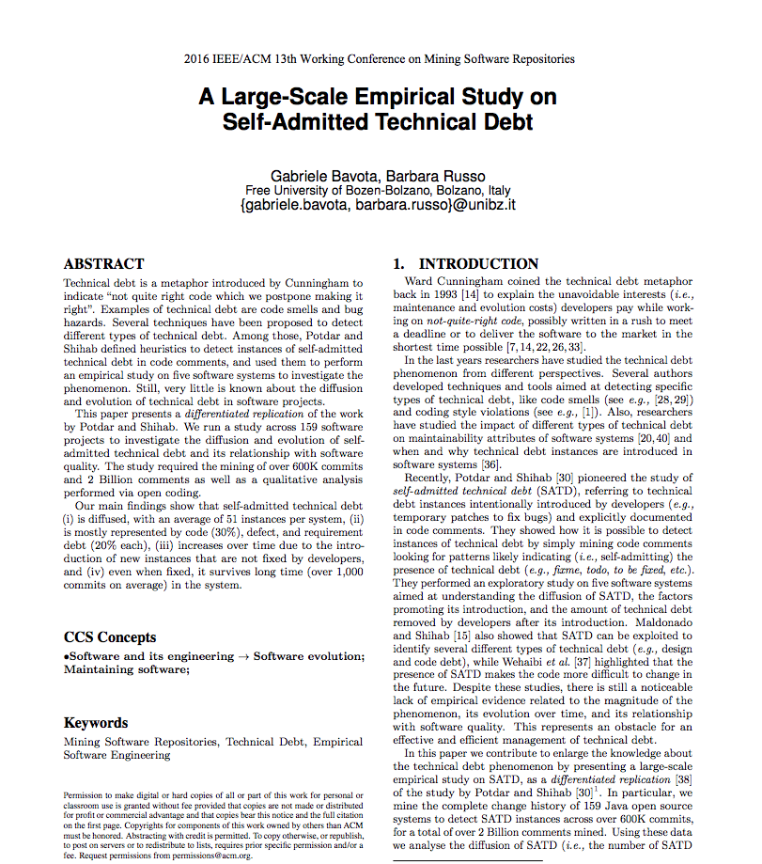
Replication Study
Examined SATD in 159 Apache and Eclipse projects
Notes:
- We find that SATD heavily depends from project to project. In some projects, we encounter as little as 2.4% of files containing SATD, and some projects containing SATD as high as 31%

Slide 30
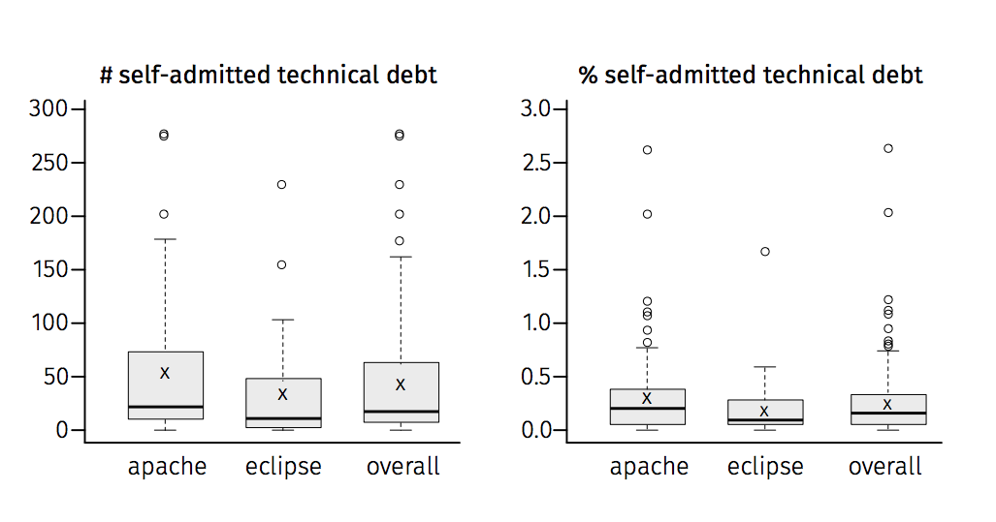
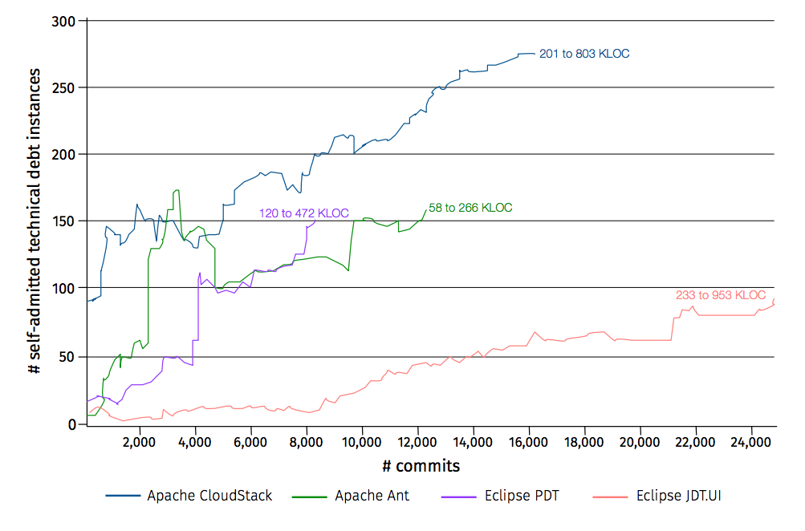
Replication Study
-SATD comments
~25% of comments were false positives
Notes:
- We find that SATD heavily depends from project to project. In some projects, we encounter as little as 2.4% of files containing SATD, and some projects containing SATD as high as 31%

Slide 31
Can we do better at detecting SATD?

Slide 32


Approach Overview
srcML
Mine Source Code
Parse code using srcML
Label SATD comments
Classify comments
10 OSS projects
~ 260K comments
~62K comments
Using NLP classifier
Notes:
- srcML – A command-line tool that converts source code into XML files
- srcML makes it easier to identify only comment lines and find the parent they are nested in
* We make the list of patterns and rest of the dataset publicly available and the link is available in the paper

Slide 33
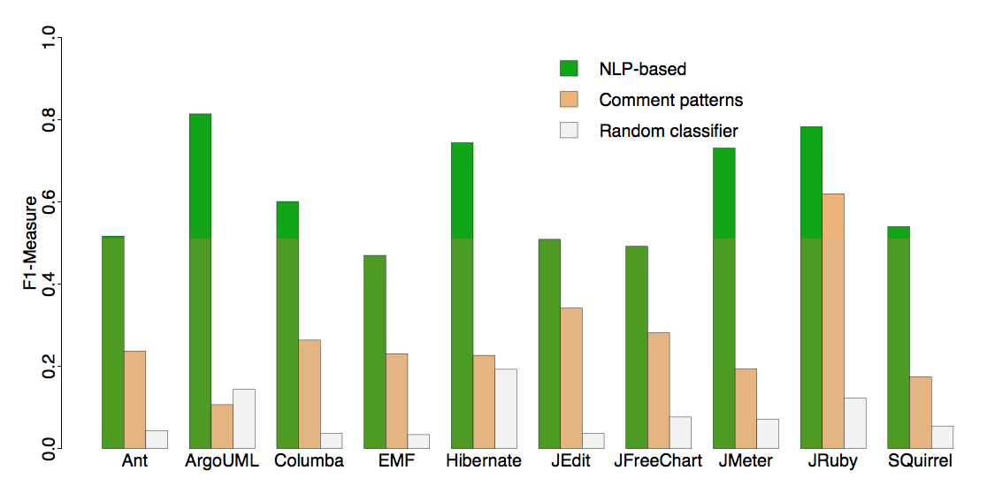
Using NLP Classifier to Detect SATD
2.3X improvement in F1 over comment patterns, mostly in recall
Notes:
- We find that SATD heavily depends from project to project. In some projects, we encounter as little as 2.4% of files containing SATD, and some projects containing SATD as high as 31%

Slide 34
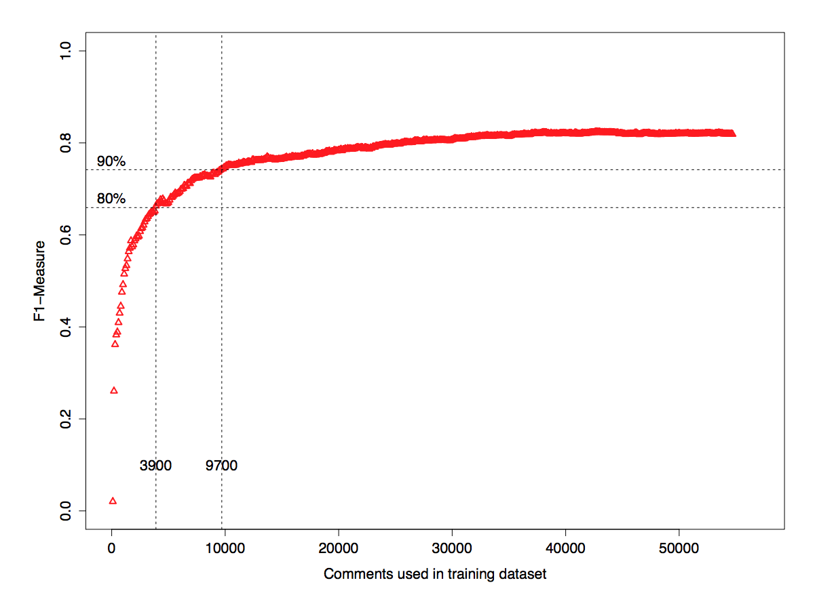
Training Data vs. F1
Notes:
- We find that SATD heavily depends from project to project. In some projects, we encounter as little as 2.4% of files containing SATD, and some projects containing SATD as high as 31%

